Slide 1
ENERGY PERSONALIZED RECOMMENDER
By:aditya jadhav
Under the guidance of Prof. Rithik Raj Vaishya

Slide 2
INTRODUCTION
An Energy Personalized Recommender(EPR) is a system designed to provide personalized recommendations to users with the goal of optimizing energy consumption, improving efficiency, and potentially reducing costs..
These systems provide homeowners with insights into their energy usage, allowing for better control to energy usage.
It is a system that collects energy data from various household appliances, processes and analyzes them, and presents the findings to users to give them insights about their energy consumption for better energy sustainability.

Slide 3
AIM
The primary aim of the Energy Personalized Recommender is to optimize energy consumption in residential settings by offering personalized recommendations tailored to individual user preferences, behaviors, and real-time energy usage patterns.
OBJECTIVE
Apply clustering algorithms k-means clustering , hierarchical clustering to
identify insights about their energy consumption for better energy sustainability.
Gain insights into the dataset's structure and relationships.

Slide 4

ALL ABOUT DATASET
The dataset name is Power Eye-datasets consists of office_strip,fridge,lamp,fridge10,tv10,food processor and charger.
This is a dataset for different household appliances which use in houses.
This data set contain with 151200 rows and 9 columns.

Slide 5
METHODOLOGY
The methodology revolves around a sequence of steps to be followed in order to reach to our target i.e. to make clusters/groups from given dataset and to calculate the performance measures of the model
Data Collection.
Data Preprocessing.
EDA.
Outlier Treatment.
Building and Training the data
K-means , Hierarchical Clustering , DBSCAN , Fuzzy clustering , T-SNE.
Evaluating the performance
Results
Conclusion

Slide 6
Key Considerations for Effective Clustering
Data Preprocessing:
Standardize and scale features to ensure uniform influence in clustering.
Handle missing values appropriately for accurate representation.
Cluster Interpretability:
Choose the number of clusters carefully based on domain knowledge or optimization techniques.
Validate and interpret clusters to extract meaningful insights about appliances patterns.

Slide 7
RESULTS
Performance Measure | K-means | Hierarchical clustering
Silhouette score | 0.5342387 | 0.580463
Calinski Harbarz score | 1545.0938 | 1497.2728
Davies Bouldin score | 0.79462125 | 0.736001

Slide 8
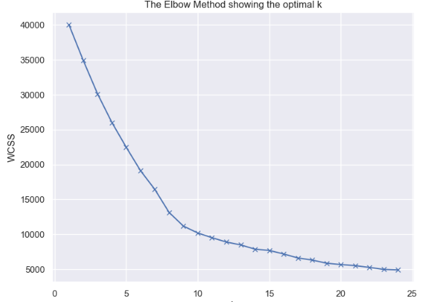
Estimation of Number of clusters:
Elbow method to estimate number of clusters

Slide 9
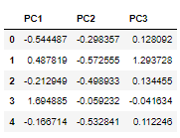
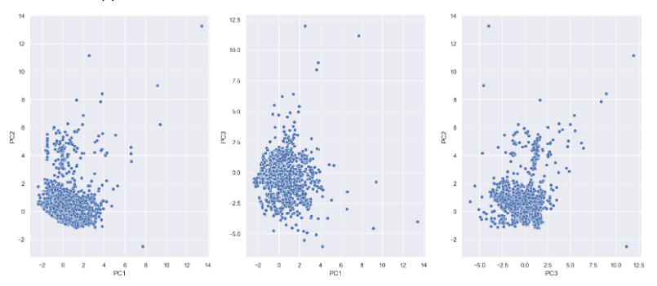
PCA(Principal Component Analysis):

Slide 10
Conclusion
Silhouette Score:
All algorithms show comparable silhouette scores, implying reasonable cluster quality.
Hierarchical clustering has a slightly higher score, indicating better-defined clusters.
Calinski-Harabasz Index:
All algorithms exhibit high values, suggesting well-separated and compact clusters.
Hierarchical clustering has a slightly higher index, indicating more distinct clusters.
Davies-Bouldin Index:
All algorithms show low values, signifying a good balance between separation and compactness.
Hierarchical clustering has a slightly lower index, indicating a slightly better balance.
Hierarchical clustering is preferred for power eye data clustering based on the evaluated metrics.
Its ability to create well-defined clusters and the higher silhouette score make it a suitable choice for extracting meaningful patterns from household appliances.

Slide 11
-THANK YOU-

